Slide 1
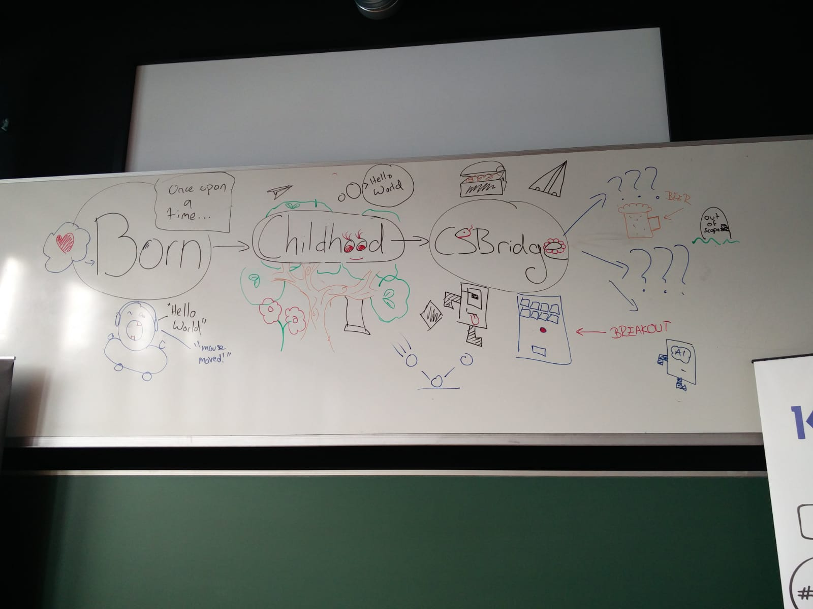
Beyond CSBridge

Slide 2
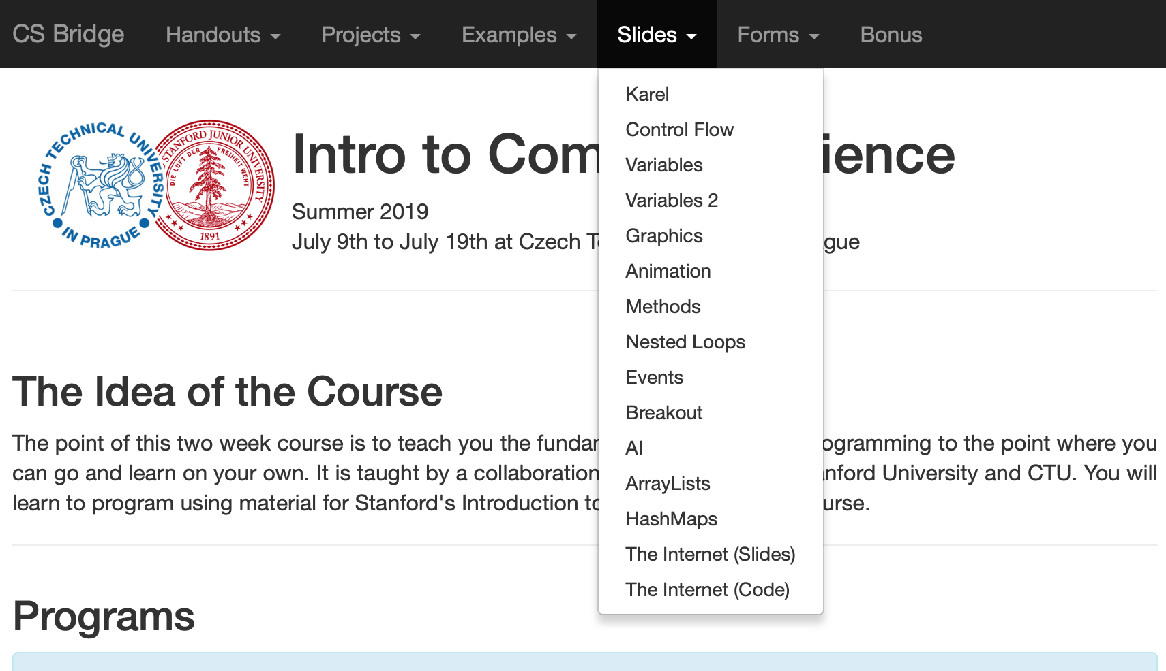
Quick Recap
Notes:
Nick

Slide 3
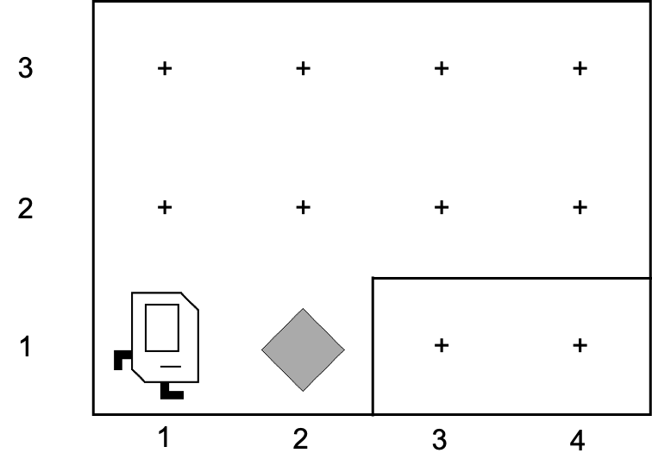
First Day

Slide 4
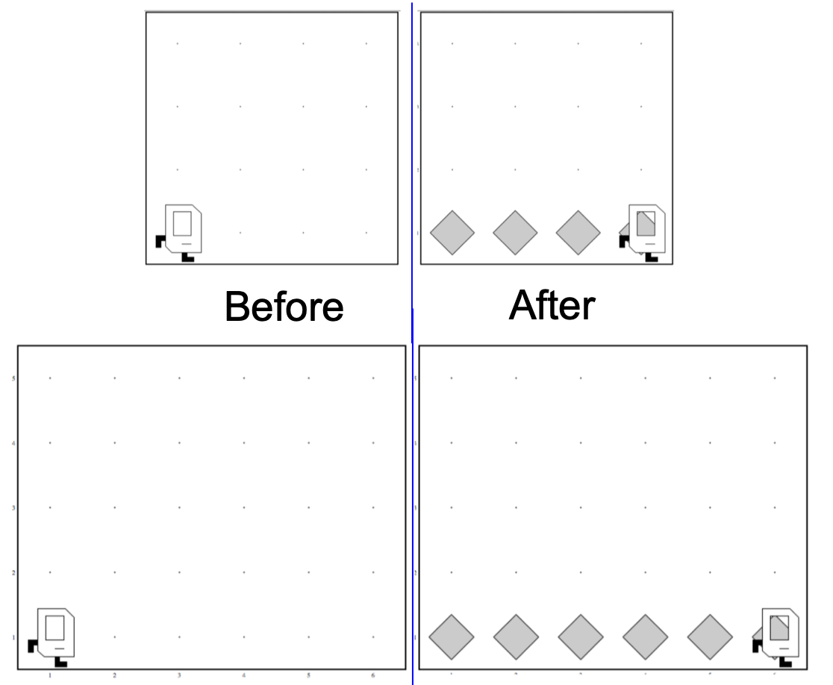
Generalization

Slide 5

Variables

Slide 6
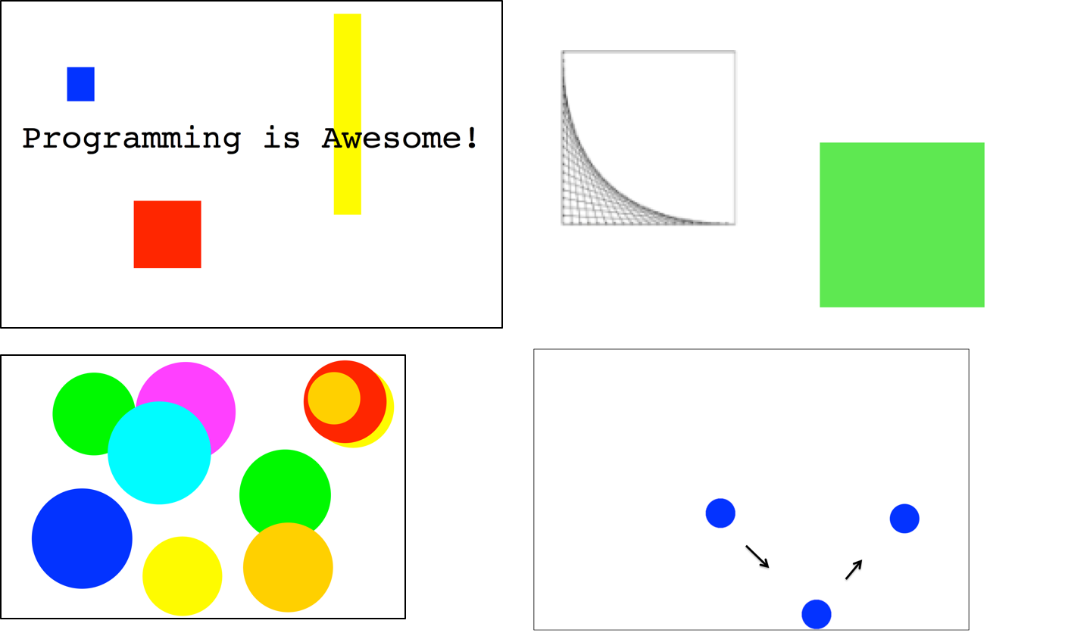
Graphics and Animation

Slide 7
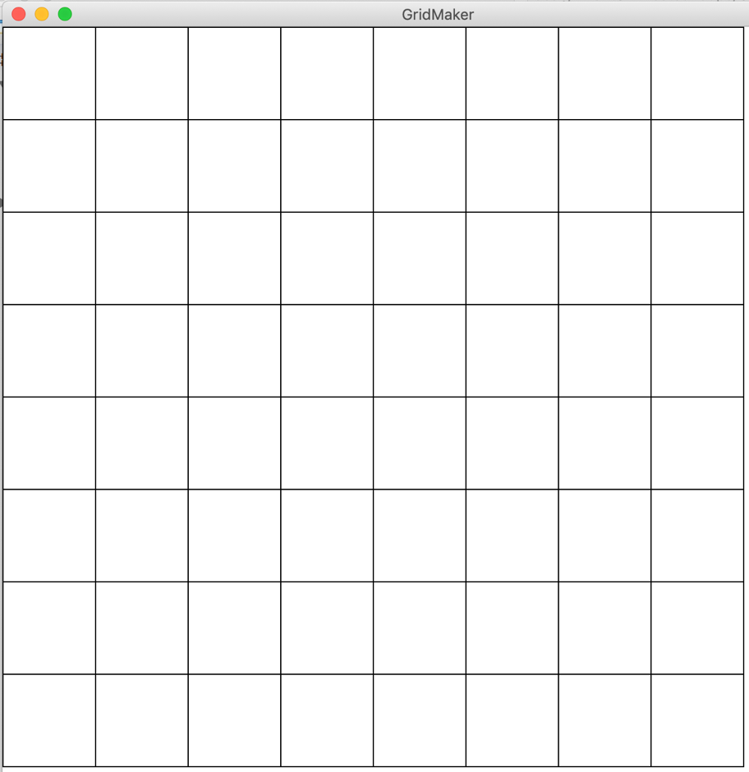
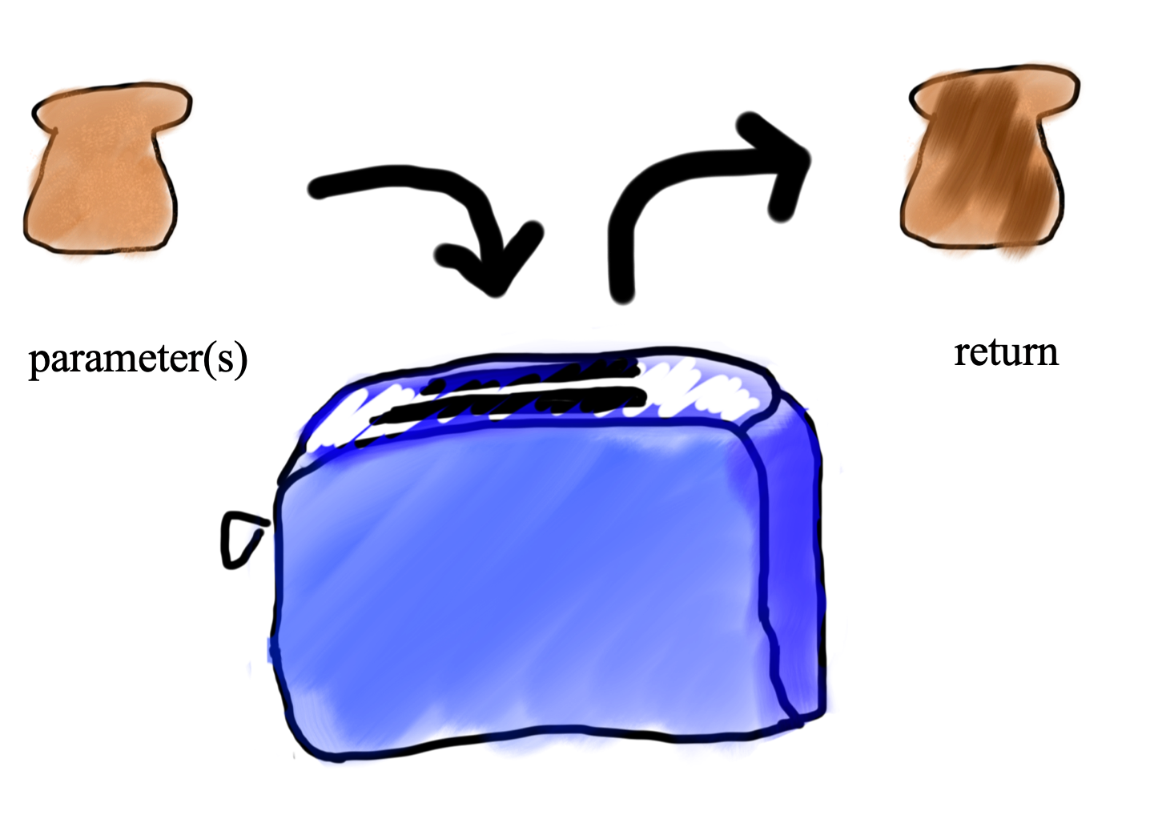
Methods and Advanced Loops

Slide 8
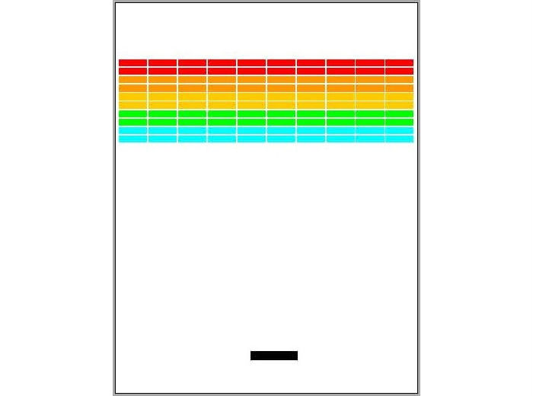
Events and Breakout

Slide 9
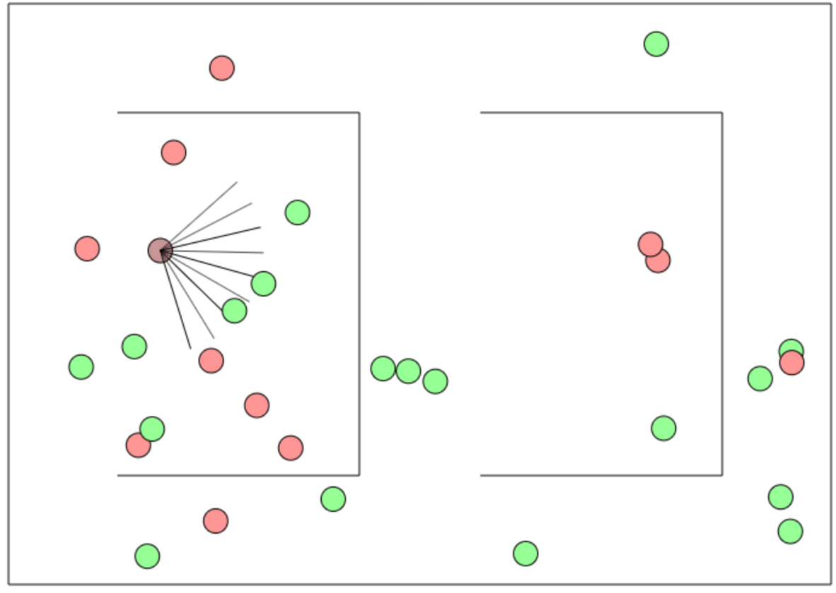
AI

Slide 10

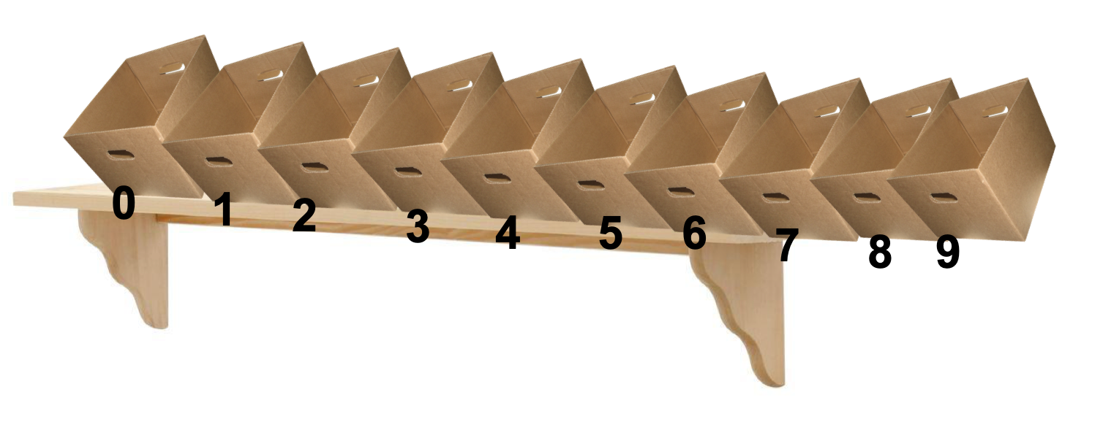
ArrayLists and HashMaps

Slide 11
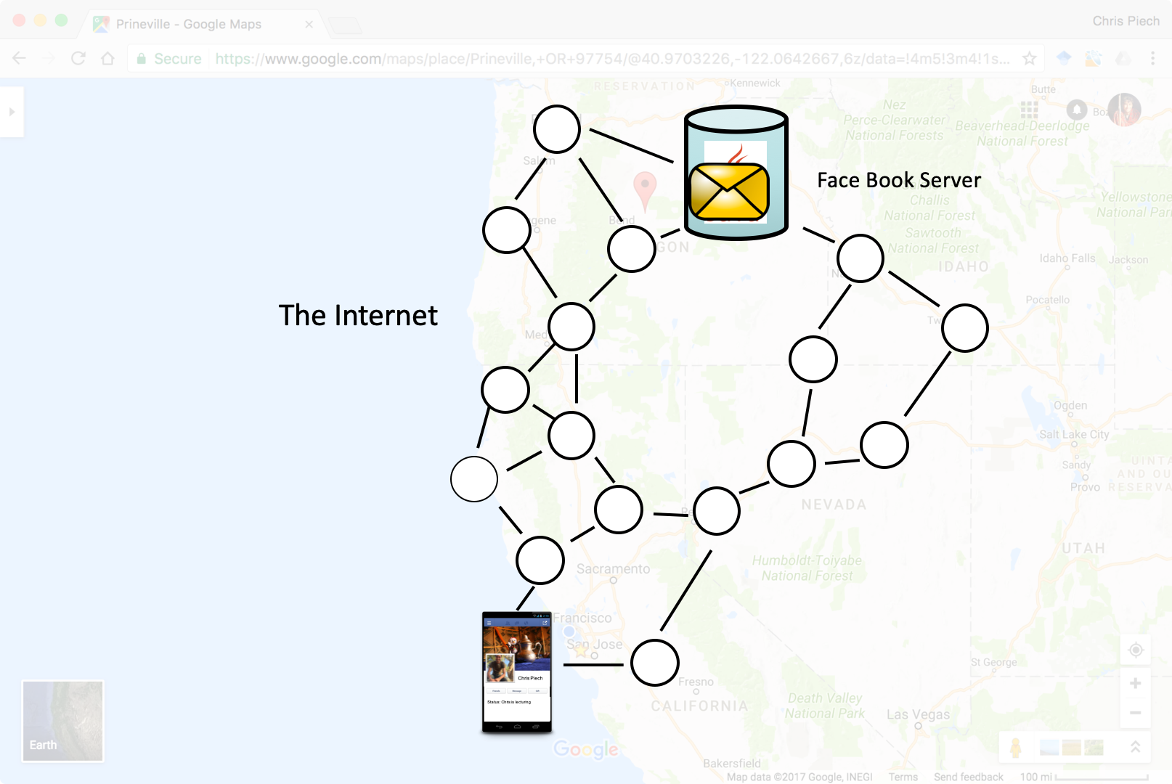
The Internet

Slide 12
Self-study
https://see.stanford.edu/Course/CS106A
https://online.stanford.edu
https://www.coursera.org/
https://www.khanacademy.org/
https://www.udemy.com/
https://www.pluralsight.com/
https://docs.oracle.com/javase/tutorial/
Notes:
Eliska + Ondra

Slide 13
Useful download links
https://www.oracle.com/technetwork/java/javase/downloads/index.html
https://www.eclipse.org/downloads/
https://web.stanford.edu/dept/cs_edu/eclipse
Notes:
Eliska + Ondra

Slide 14







Stay in touch!
Eliška Ondra
@sestaeli
@guthondr @chrispiech
esestakova
Eleez trpasle
trpasle
Theia trpasle
sestaeli ondrejguth
www.studuj-uspesne.cz
@StudujUspesne
facebook.com/StudujUspesne
Notes:
Eliska + Ondra

Slide 15
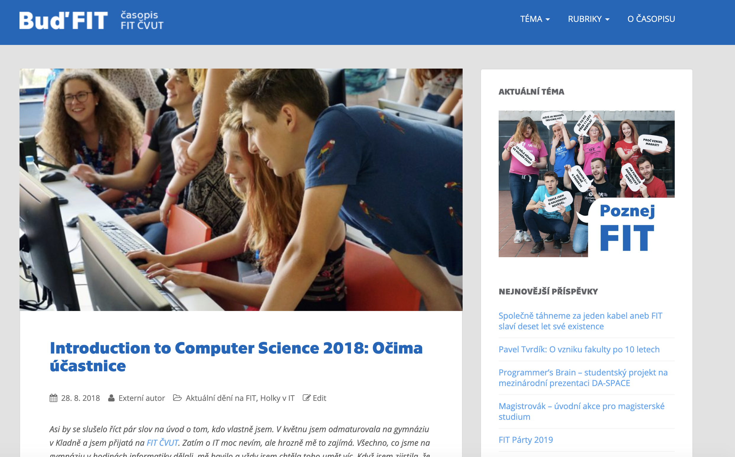

Be a star!
https://casopis.fit.cvut.cz/deni-na-fit/introduction-to-computer-science-2018-ocima-ucastnice/
Notes:
Eli

Slide 16
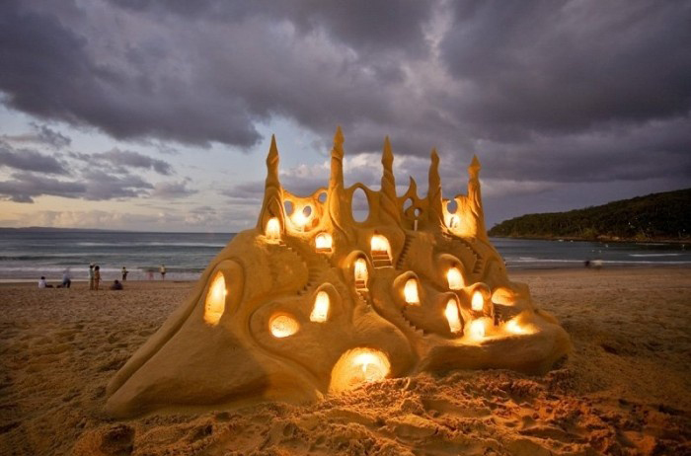
Joy of Building

Slide 17


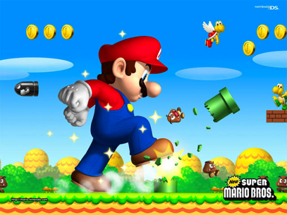

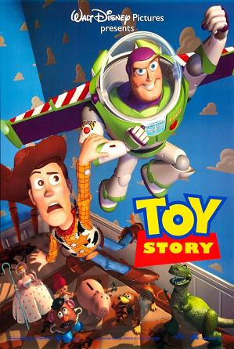
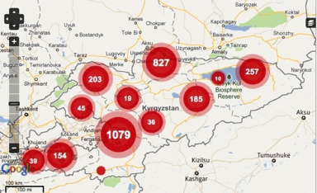
Notes:
Super Mario: Japan
Angry Birds: Finland
Pixar: USA
Ushahidi: Kenya

Slide 18

Closest Thing to Magic

Slide 19
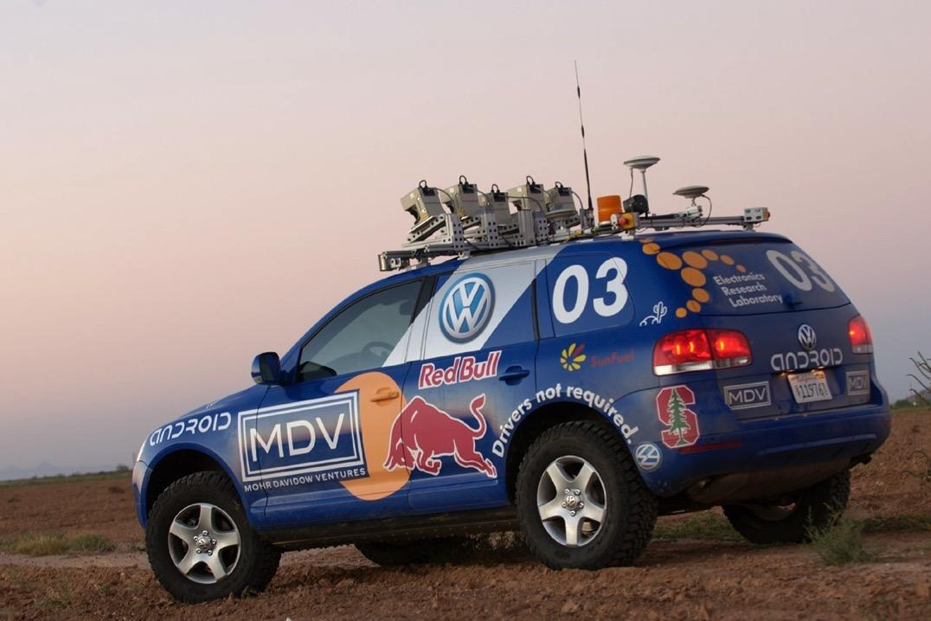
Now is the time!

Slide 20
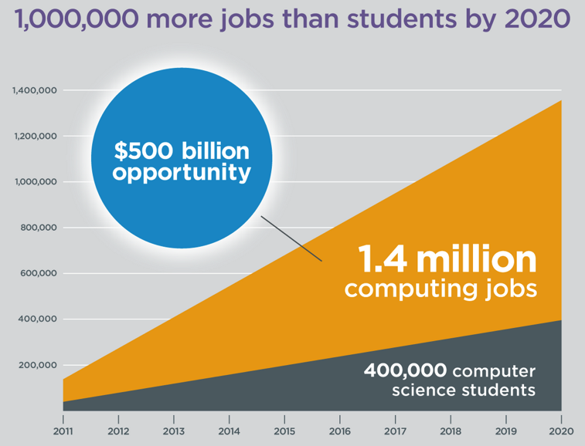
Oh and it’s useful
Code.org

Slide 21

Everyone is welcome
Tell your friends :-)

Slide 22


Keep Learning by Doing
// good life
while(true) {
learn();
play();
love();
pause(8);
}

Slide 23
You should be proud of yourselves
Notes:
Not nearly enough adults in the world are able to do what you have now demonstrated!

Slide 24


